Slide 1
Distributed Programming and Networking – AA 2022/2023
Project proposal: A System for Providing Medical Services To The Patients
Authors: Hsham, Taofik, Daniel
(ngim.hsham@gmail.com, taofikahmed.suleiman@studentmail.unicas.it, dtanyimadu@gmail.com )

Slide 2
Outline
Abstract (500 words maximum)
Mockup of the application with a brief description
Client-side languages, environment and technologies
Server-side languages, environment and technologies
Timetable (hint: SCRUM framework, https://www.scrum.org/ )

Slide 3
Abstract
The project represents a small medical system for a medical center that will provide medical services to patients.
This system has five modules (Users-Patients-Doctors-Services-Transactions).
Each patient must be registered to be able to receive medical services.
The administrators must add a bunch of medical services to the system in order to provide patients.
Each transaction in the system depends on (The id of the user, the id of the patient, the id of the doctor, and the id of the services )

Slide 4
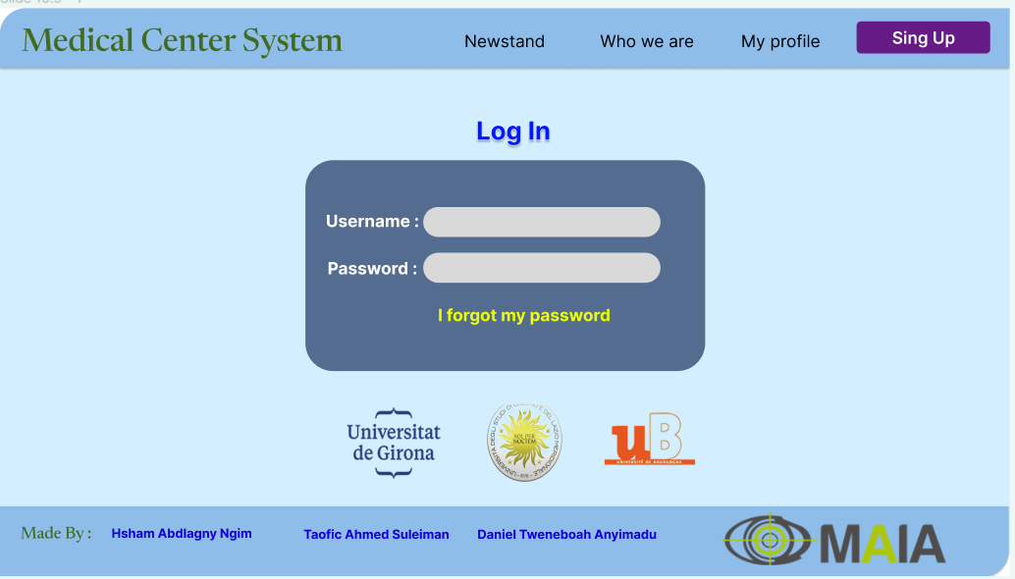
Mockup
Login (Must have)
Sign-in, Patients, Doctors, Services, transactions.
Admin Dashboard: For administrators to manage healthcare providers, patient records, and medical services.
Patient Registration: New patients can register their details, including personal information, and contact information.
Doctor Registration: New doctors can register their details, including personal information, and their major.
Medical Services: After Healthcare providers wrote some medical procedures, the administrators will insert them into patients’ medical files.

Slide 5
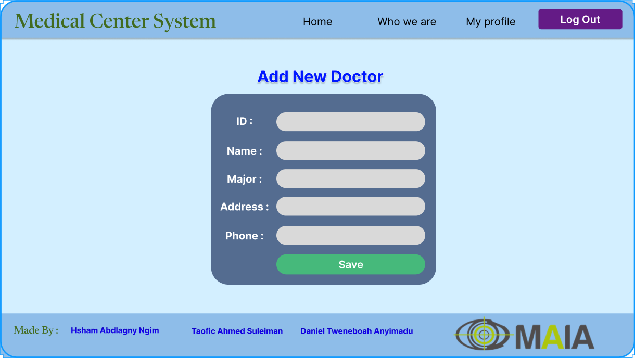
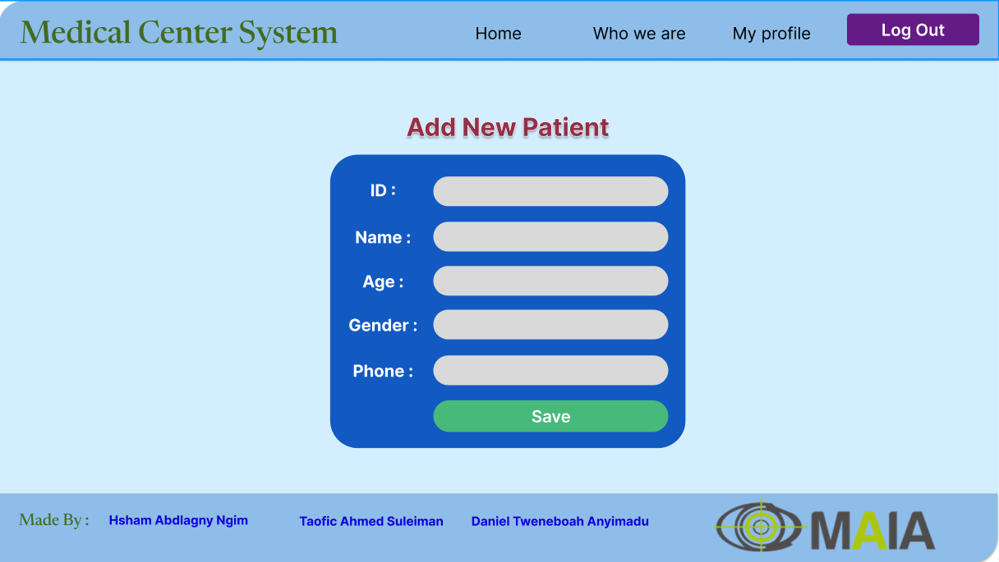
Mockup
Add Details of Doctors & Patients (Must have)

Slide 6
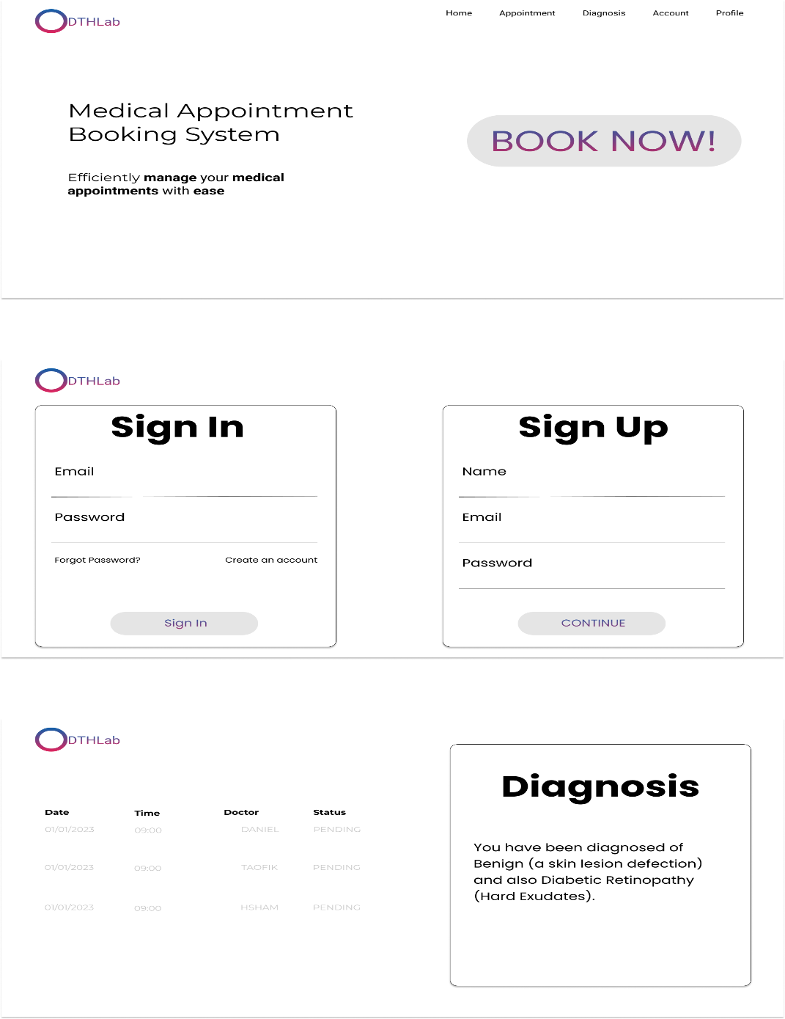
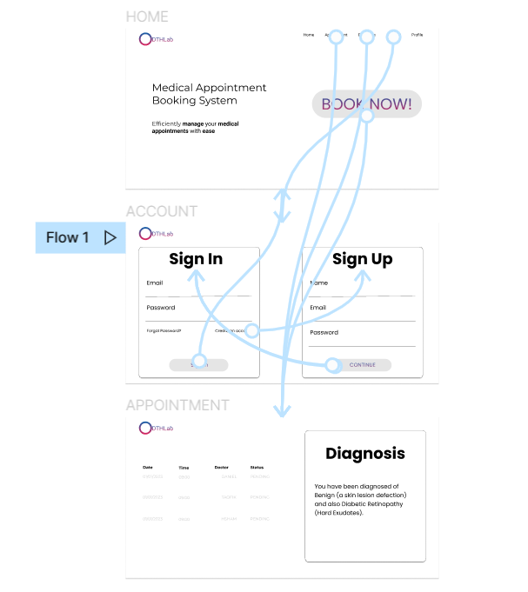
Mockup

Slide 7
Mockup
User info update (Should have)
Search and Filter: Allow administrators to search for healthcare providers based on specialization, availability, or location.
Appointment History: Maintain a record of past appointments for reference and analysis.
Appointment Reminders: Send automated reminders to patients and healthcare providers about upcoming appointments via email or SMS.
Reporting and Analytics: Generate reports and statistics on appointment trends, patient demographics, etc.
Multi-language Support: Provide support for multiple languages to cater to a diverse user base.

Slide 8
Mockup
User info update (Could have)
Integration with External Calendars: Enable synchronization of appointments with popular calendar applications like Google Calendar or Outlook.
Prescription Management: Allow healthcare providers to generate and manage digital prescriptions for patients.
Waitlist Management: Implement a waitlist feature to notify patients in case of cancellations or rescheduling.
Telemedicine Integration: Integrate video conferencing tools to facilitate virtual consultations between patients and healthcare providers.
Mobile Application: Develop a mobile application for convenient appointment management on the go.

Slide 9
Client side
Languages, environment and technologies
The client-side of the application utilizes HTML, CSS, and JavaScript to create a dynamic and interactive user interface.
JavaScript: Enables client-side interactivity, form validation, and dynamic behavior.
JSON
HTML, CSS, Jquery: Provides the structure, layout and visually appealing layout of the web pages.

Slide 10
Server side
Languages, environment and technologies
The server-side of the application leverages Java Struts2 framework to handle server-side processing, facilitate communication between the front-end and back-end, and implement business logic.
MySQL: Serves as the database management system to store and manage appointment-related data, utilizing SQL queries to interact with the database.
Tomcat
Java: The primary language for server-side development, allowing for the implementation of robust business logic.
Struts2: Provides a framework for building web applications with support for MVC (Model-View-Controller) architecture, request handling, validation, and routing.

Slide 11
Timetable
Timetable (based on SCRUM or GANTT diagram or other models …)
DATE: 05/06/2023
System Design and Mockup Creation
Front-end Development
Back-end Development
Database Management
Integration and Testing
Deployment

Slide 12
Thank you
FOR YOUR ATTENTION

